Slide 1

Employee Data Analysis using Excel
1
STUDENT NAME : SWETHA S
REGISTER NO : 312217231
DEPARTMENT : B.COM (GENERAL)
COLLEGE : SHRI KRISHNASWAMY COLLEGE FOR WOMEN
Notes:
1

Slide 2

2
PROJECT TITLE
Salary And Compensation Analysis Through Excel Data Modeling

Slide 3



AGENDA
3
Problem Statement
Project Overview
End Users
Our Solution and Proposition
Dataset Description
Modelling Approach
Results and Discussion
Conclusion
3/21/2024 Annual Review

Slide 4

PROBLEM STATEMENT
4
"Organizations often struggle to effectively analyze and optimize their salary and compensation structures due to a lack of systematic data analysis. This project aims to utilize Excel data modeling techniques to analyze salary and compensation data, identify trends and disparities, and provide actionable insights for equitable compensation practices. The goal is to enhance data-driven decision-making and ensure competitive and fair compensation strategies within the organization.".

Slide 5

5
PROJECT OVERVIEW
.
This project focuses on analyzing salary and compensation data using Excel data modeling. The goal is to identify salary trends, detect disparities, and benchmark compensation against industry standards. By applying advanced Excel techniques, the project will provide actionable insights to enhance compensation strategies, ensure fairness, and support data-driven decision-making for better organizational outcomes."

Slide 6

6
WHO ARE THE END USERS?
HR Professionals & HR Departments :
For developing equitable compensation strategies and policies.
For optimizing compensation policies and ensuring fairness.
Compensation Analysts:
To identify pay trends and disparities.
Finance Teams:
For budget planning and financial forecasting.
To align salaries with budgetary constraints and forecasts.
Executives:
To make informed decisions on salary structures and adjustments.
For strategic planning and competitive positioning in the market.
Employees: As beneficiaries of fair and transparent compensation practices.
Management: To make informed decisions on salary adjustments and equity.

Slide 7

7
OUR SOLUTION AND ITS VALUE PROPOSITION
Value Proposition:
Clear Insights: Provides a clear view of salary patterns and issues.
Competitive Edge: Keeps salaries aligned with market rates to attract and retain talent.
Equitable Pay: Ensures fair pay practices across the organization.
Solutions:
Detailed Salary Analysis: Uses Excel to break down and understand salary data.
Market Comparison: Compares salaries to industry standards to stay competitive.
Fairness Check: Finds and fixes any pay gaps to ensure fair compensation.

Slide 8
Dataset Description
8
Emp ID
Name
Gender
Department
Salary
Start Date
FTE
Employee type
Work location

Slide 9

9
THE "WOW" IN OUR SOLUTION
The "wow" factor in our solution for salary and compensation analysis through Excel data modeling lies in its ability to transform complex data into actionable insights with clarity and precision. By using advanced Excel features like pivot tables, dynamic charts, and custom formulas, our model offers:
Interactive Dashboards: Engaging and user-friendly dashboards that visualize salary distributions, trends, and disparities at a glance, making data interpretation intuitive and impactful.
Scenario Analysis: The ability to model different compensation scenarios and forecasts, allowing for strategic planning and what-if analysis to anticipate and address potential issues.
Automated Insights: Streamlined data processing and automated reporting that significantly reduce manual effort and errors, providing reliable and timely insights.
Equity and Benchmarking: In-depth analysis of compensation equity and alignment with market benchmarks, helping ensure fair and competitive remuneration practices.
Overall, the solution not only simplifies complex data management but also empowers decision-makers
3/21/2024 Annual Review

Slide 10
MODELLING
10
Organize Data: Set up salary and compensation information in a structured way in Excel.
Analyze Trends: Use Excel tools to spot patterns, such as which roles have higher or lower pay.
Compare Benchmarks: Check how your salaries match up against industry standards to ensure competitiveness.
Identify Disparities: Find any differences in pay between different groups or roles to address fairness.
Visualize Data: Create charts and graphs to make the data easier to understand and use in decision-making.

Slide 11
RESULTS
11
Clear Salary Trends:
Identified patterns and trends in salary distributions across different roles and departments.
Benchmark Insights:
Provided comparisons of internal salaries against industry standards, highlighting areas where adjustments may be needed.
Equity Analysis:
Revealed pay disparities and gaps, enabling corrective actions to ensure fair compensation practices.
Informed Decisions:
Delivered actionable insights for strategic salary adjustments and budget planning.
Visual :
.
Identified Pay Patterns:
Found trends in how salaries are distributed across roles and departments.
Benchmark Comparisons:
Compared salaries with industry standards to see if they are competitive.
Detected Pay Gaps:
Uncovered differences in pay to address fairness issues.
Supported Decisions:
Provided useful information for making salary adjustments and planning budgets.
Visual Insights & Reports:
Created easy-to-understand charts and graphs to present the findings clearly.
Produced charts and graphs that effectively communicated findings and supported data-driven decision-making

Slide 12
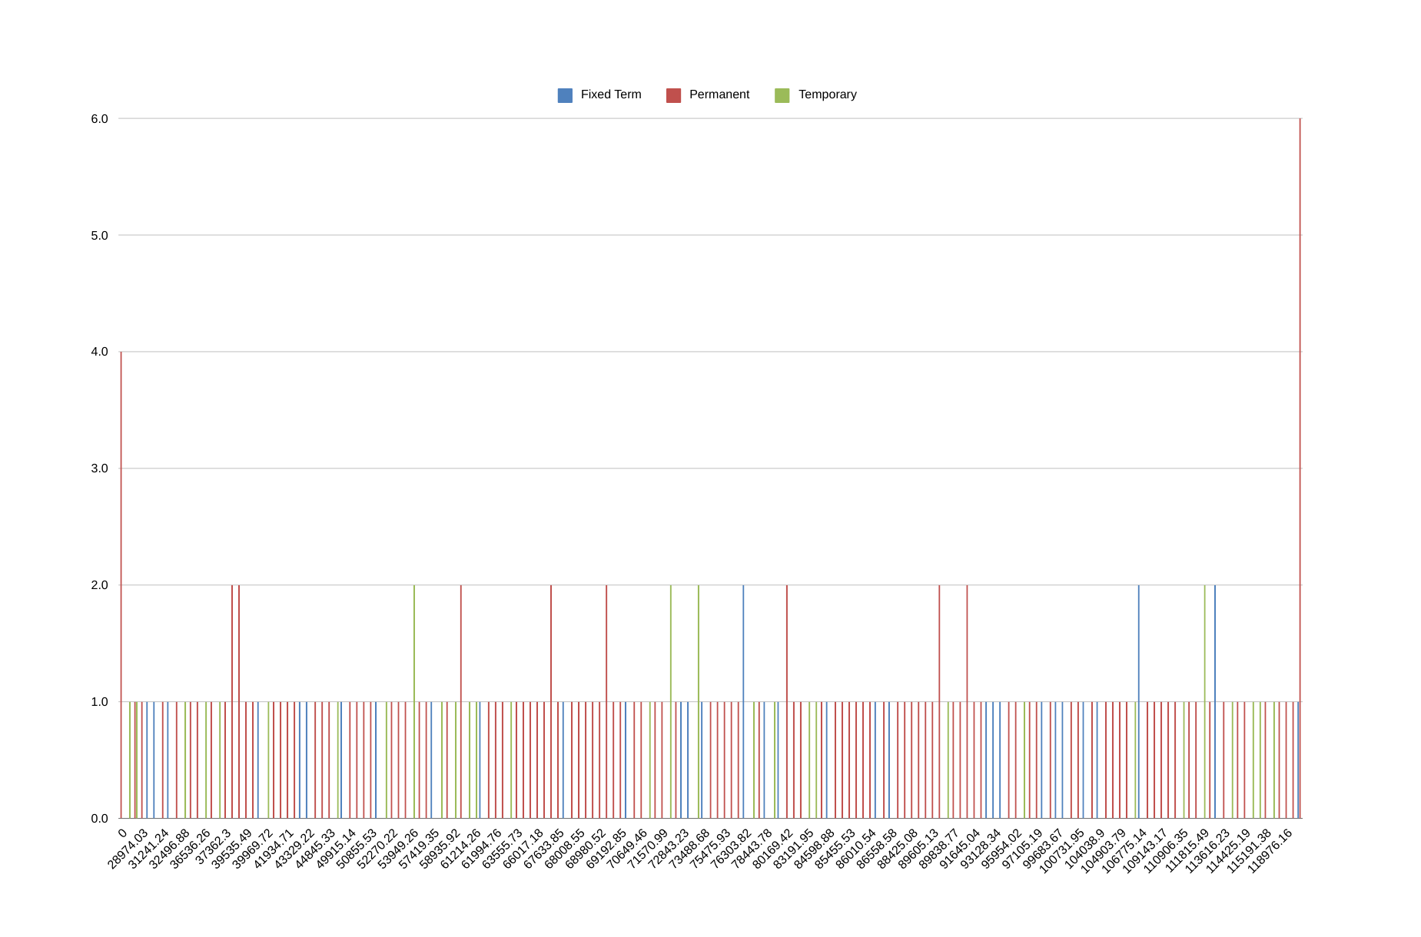
12

Slide 13
conclusion
In conclusion, the salary and compensation analysis through Excel data modeling provides a robust framework for understanding and optimizing employee remuneration within an organization. By leveraging Excel’s powerful data analysis and visualization tools, we can derive actionable insights into salary distribution, compensation equity, and market competitiveness.
Excel’s versatility in handling large datasets, coupled with its advanced analytical functions, enables a comprehensive examination of various compensation factors, including base salary, bonuses, and benefits..
Overall, Excel data modeling serves as an invaluable tool for making data-driven decisions in salary and compensation management, ultimately contributing to a more equitable and competitive compensation strategy.
In summary, Excel data modeling for salary and compensation analysis provides a clear, data-driven approach to evaluate and optimize employee remuneration. By analyzing salary distributions and compensation structures, it helps identify disparities, ensure equity, and align with industry standards. This method supports informed decision-making and strategic adjustments to improve compensation practices and enhance organizational competitiveness.

